Slide 1
Docker Assignment
Atypon Training Program 2023
By Yussif Abdalla

Slide 2
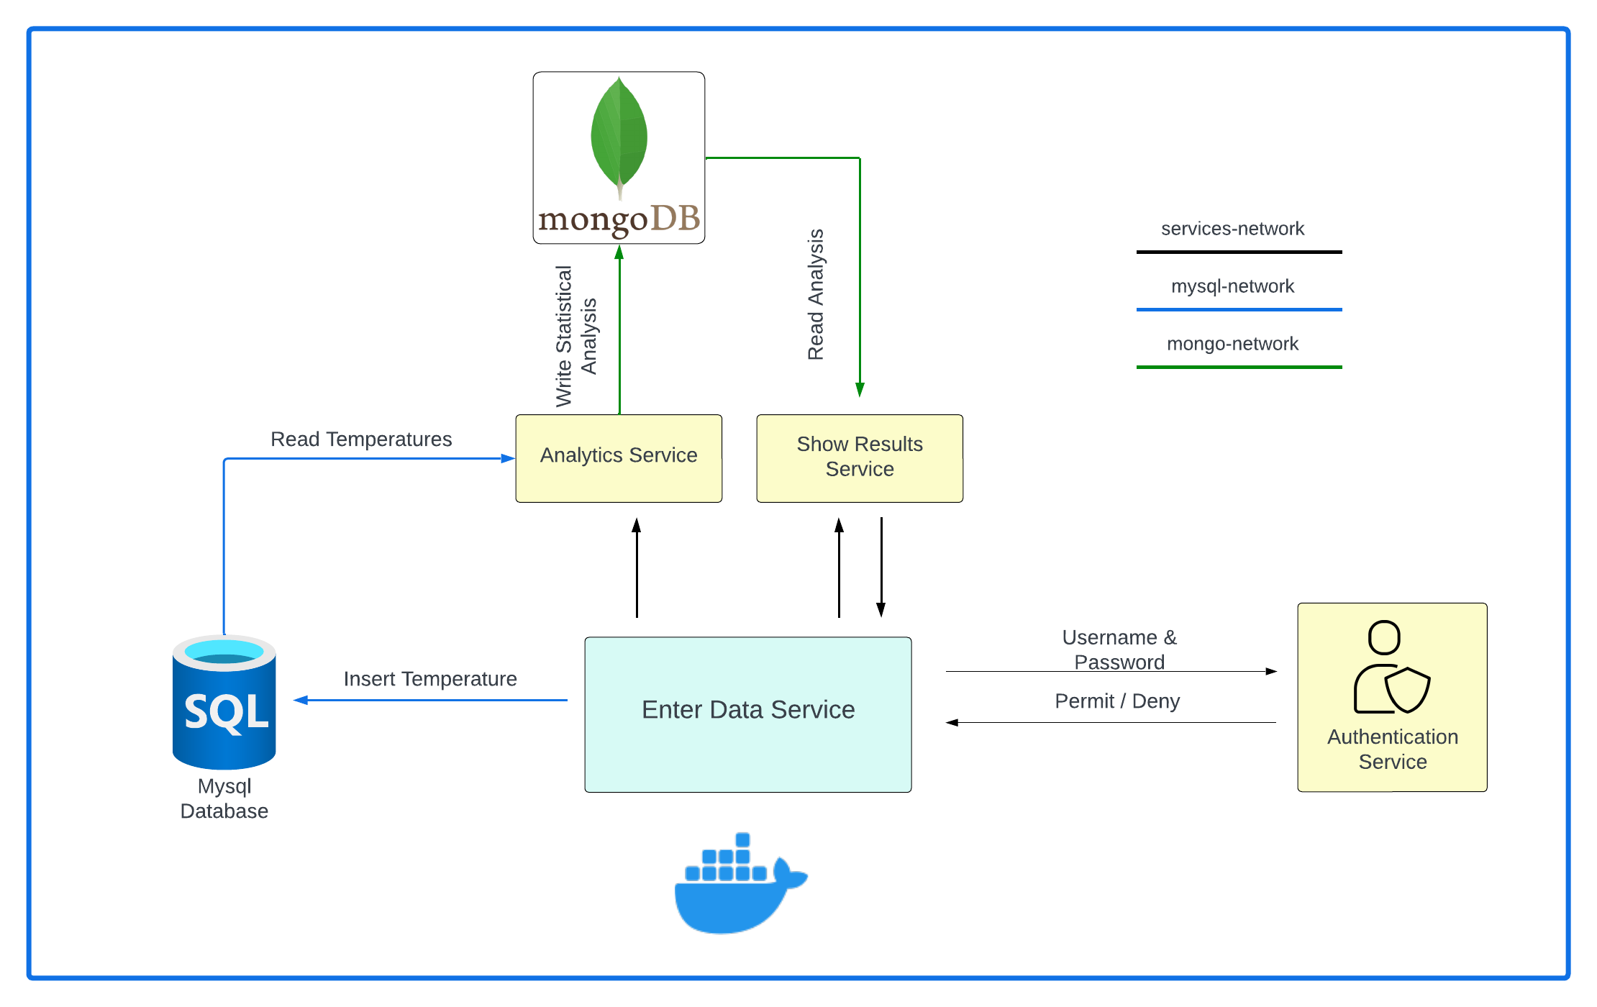
Microservices System Design

Slide 3
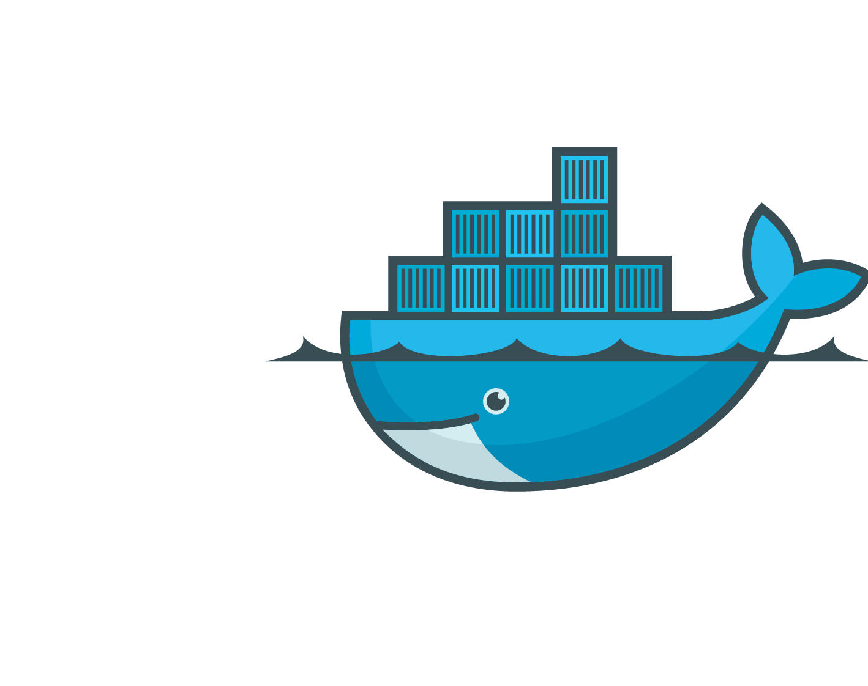
The Services Docker Files
Dockerfile

Slide 4
The Dockerfile
From openjdk:20
Copy ./target/springservice-0.0.1.SNAPSHOT.jar springservice-0.0.1.SNAPSHOT.jar
CMD [“java”, “-jar”, “springservice-0.0.1.SNAPSHOT.jar”]

Slide 5
The Docker Compose File
docker-compose.yml

Slide 6
The Enter Data Service
version: "3.8"
services:
enter-data-service:
image: enter-data-service
ports:
- "8080:8080“
networks:
- mysql-network
- services-network
depends_on:
- mysqldb
- authentication-service

Slide 7
The Authentication Service
authentication-service:
image: authentication-service
ports:
- "8081:8081“
networks:
- services-network

Slide 8
The Show Results Service
Show-results-service:
image: show-results-service
ports:
- "8084:8084“
networks:
- mongo-network
- services-network
depends_on:
- enter-data-service
- mongodb

Slide 9
mysqldb
mysqldb:
image: mysql:8
networks:
- mysql-network
ports:
- "3307:3306“
volumes:
- ./init.sql:/docker-entrypoint-initdb.d/init.sql
environment:
MYSQL_ROOT_PASSWORD: root
MYSQL_DATABASE: temperature

Slide 10
mongodb
mongodb:
image: mongo
networks:
- mongo-network
ports:
- "27017:27017"

Slide 11
Docker Compose Networks
networks:
services-network:
mysql-network:
mongo-network:

Slide 12
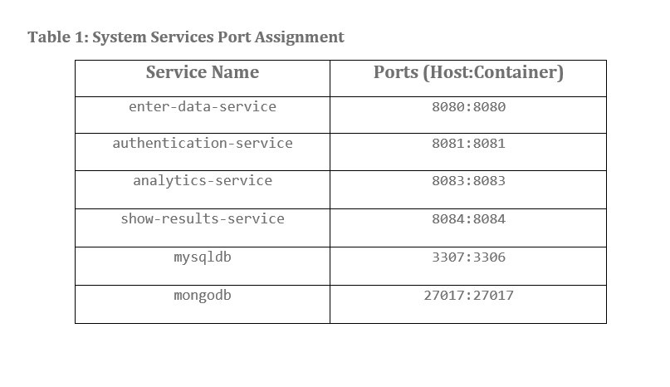
Port Assignment

Slide 13
Thank You

